Slide 1


Sakila Project
By:
Lotfy Ahmed lotfy
Joy Hany Nicola
Mina Khalil Aziz
Karolos Mahrous
Mary Kamal Bebawy
Notes:
To change the image on this slide, select the picture and delete it. Then click the Pictures icon in the placeholder to insert your own image.

Slide 2
What is Sakila?
Sakila is a sample database commonly used for practicing with SQL queries and database management systems. It's often employed in educational settings, tutorials, and demonstrations to provide a realistic yet manageable dataset for learning and practicing SQL concepts.
The Sakila database typically consists of several tables that represent different aspects of a DVD rental store.

Slide 3
What kind of data sakila consist of?
Actors : Name
Film: Title, Release Year, Length, Rental Duration, Category, Features
Store: Address
Customer: Name, address, phone, Activity
Staff: name, address, Email, phone
Rentals: Rental Date, Return Date
Payment : Payment Date , Amount

Slide 4
Questions about the Data.
How does the rental frequency vary by Year?
Can we identify any seasonal trends in DVD rentals based on rental dates?
Is there a relationship between the length of a film and its rental frequency?
What is the average number of rentals per customer?
Which Cities or Countries have the most Rental frequency?
How staff Performance vary by Year?
…..

Slide 5
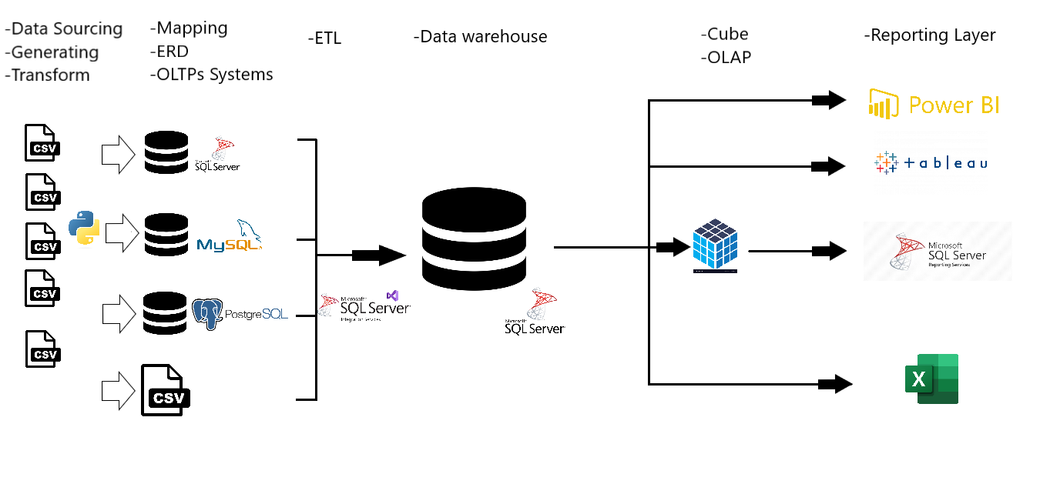
Project Map

Slide 6
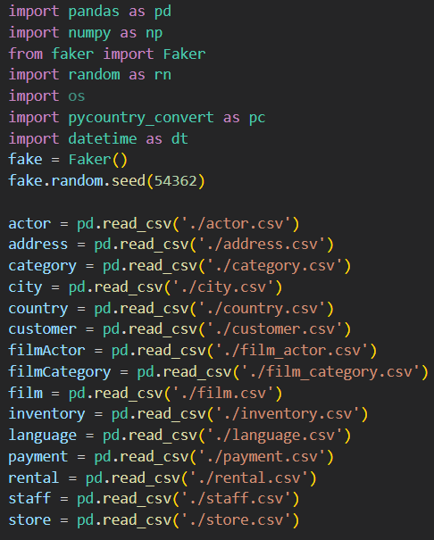
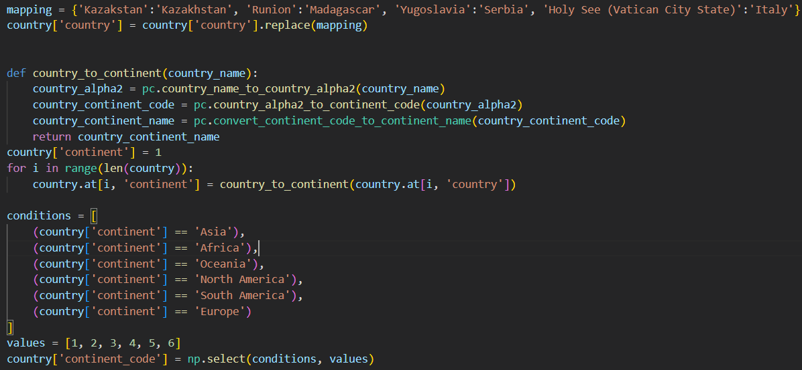
Data sourcing Layer -Data generating

Slide 7
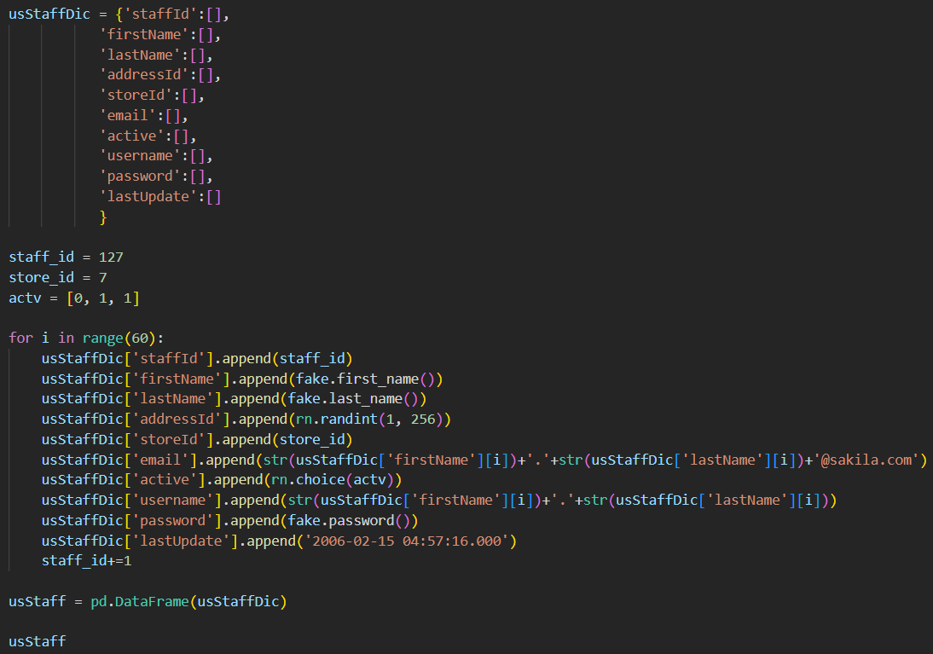
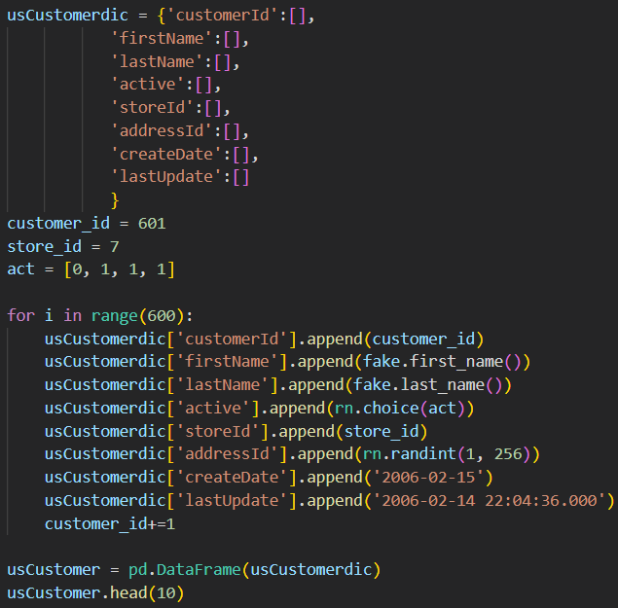
Data sourcing Layer -Data generating

Slide 8
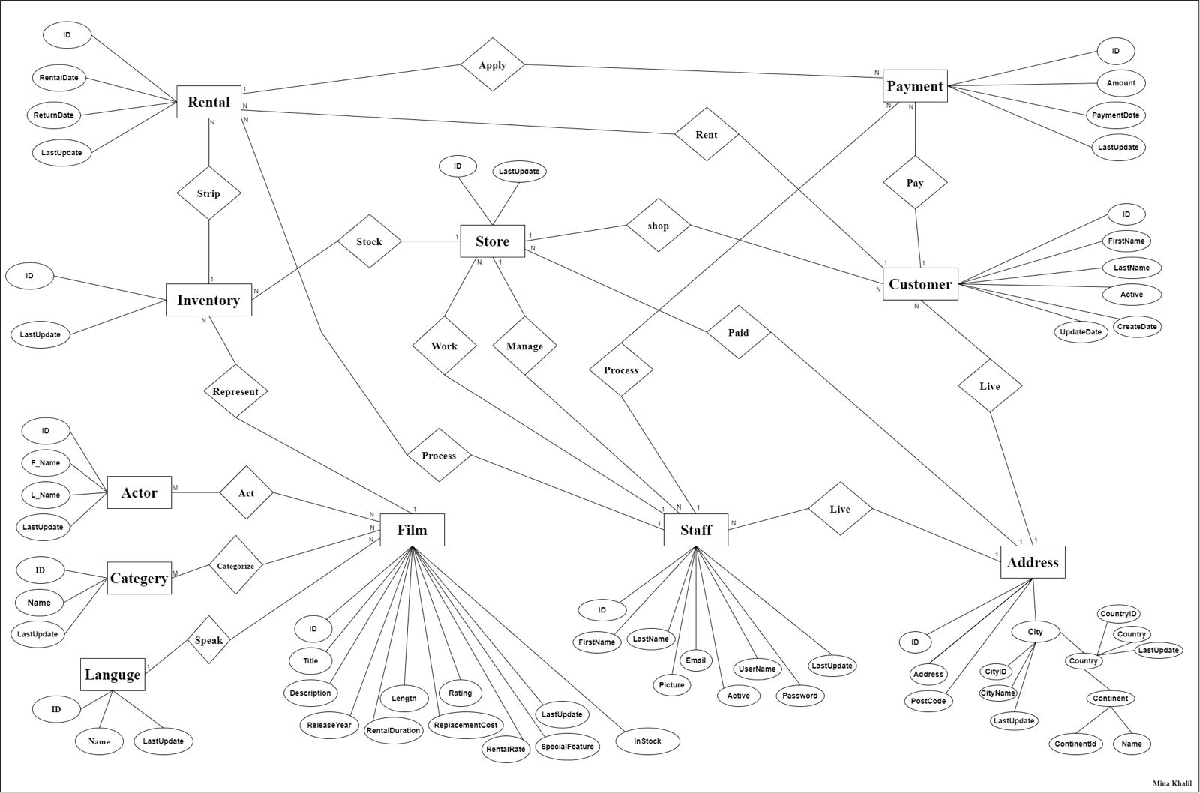
OLTPs Layer -ERD

Slide 9
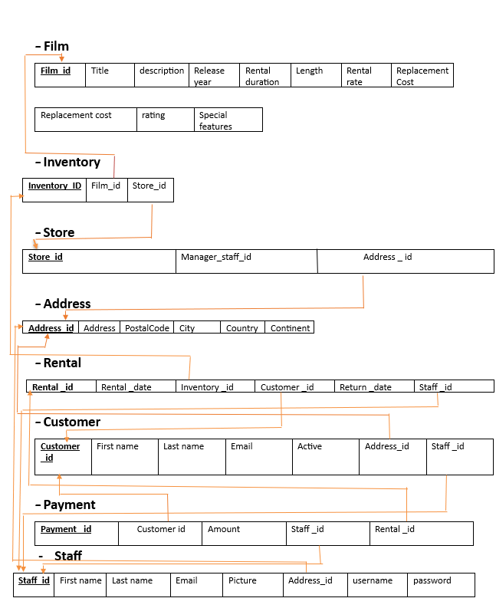
OLTPs Layer -Mapping

Slide 10
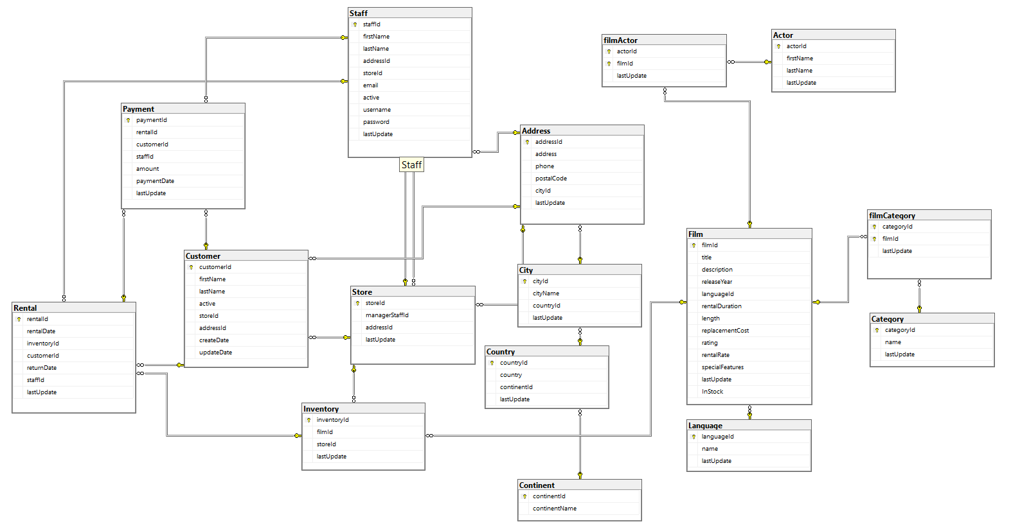
OLTPs Layer -Database Diagram on SQL-Server

Slide 11
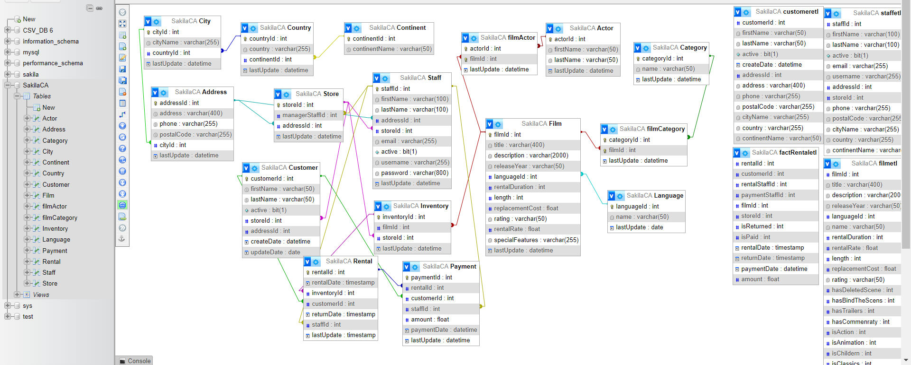
OLTPs Layer -Database Diagram on MySQL

Slide 12
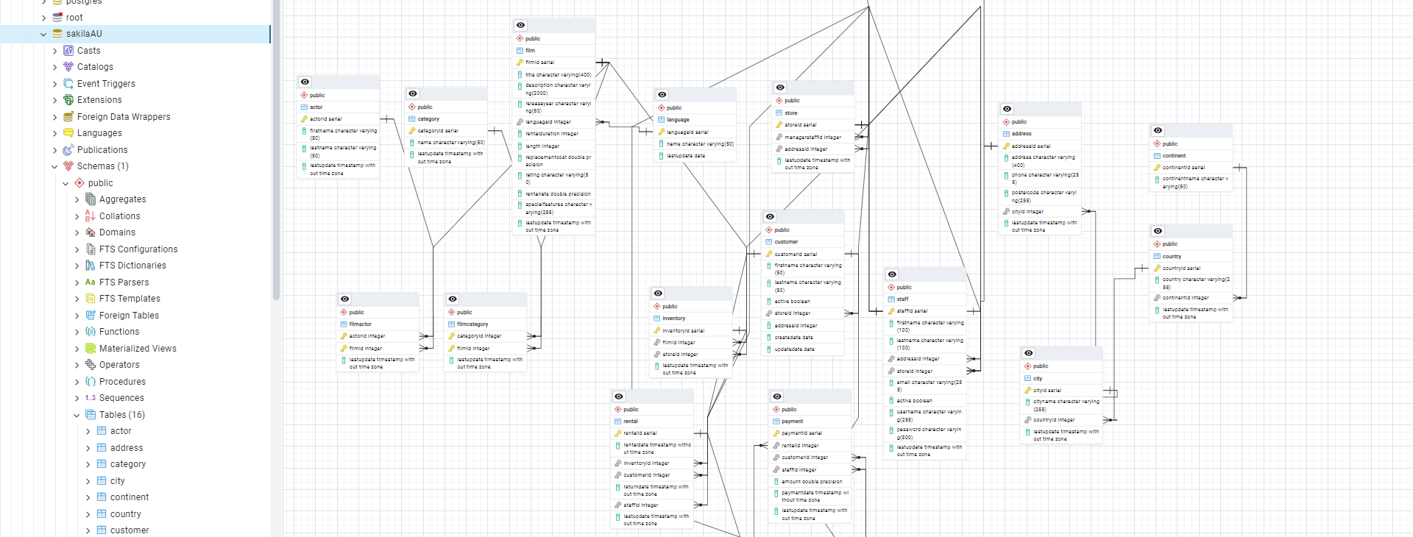
OLTPs Layer -Database Diagram on PostgreSQL

Slide 13
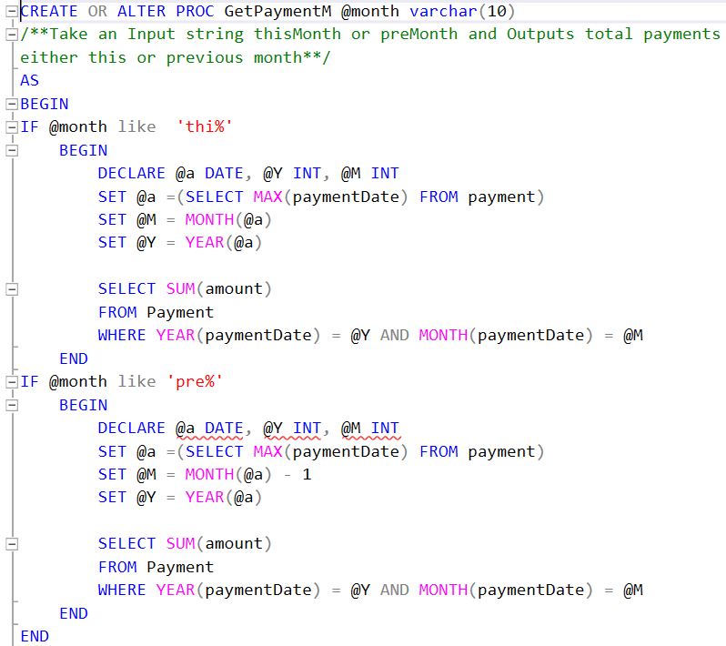
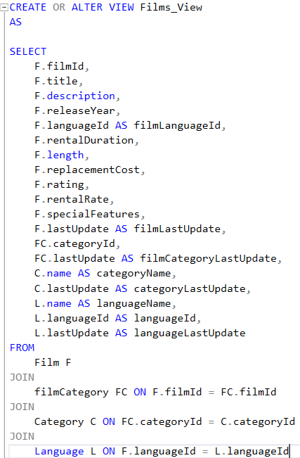
OLTPs Layer -Views and Stored procedures

Slide 14
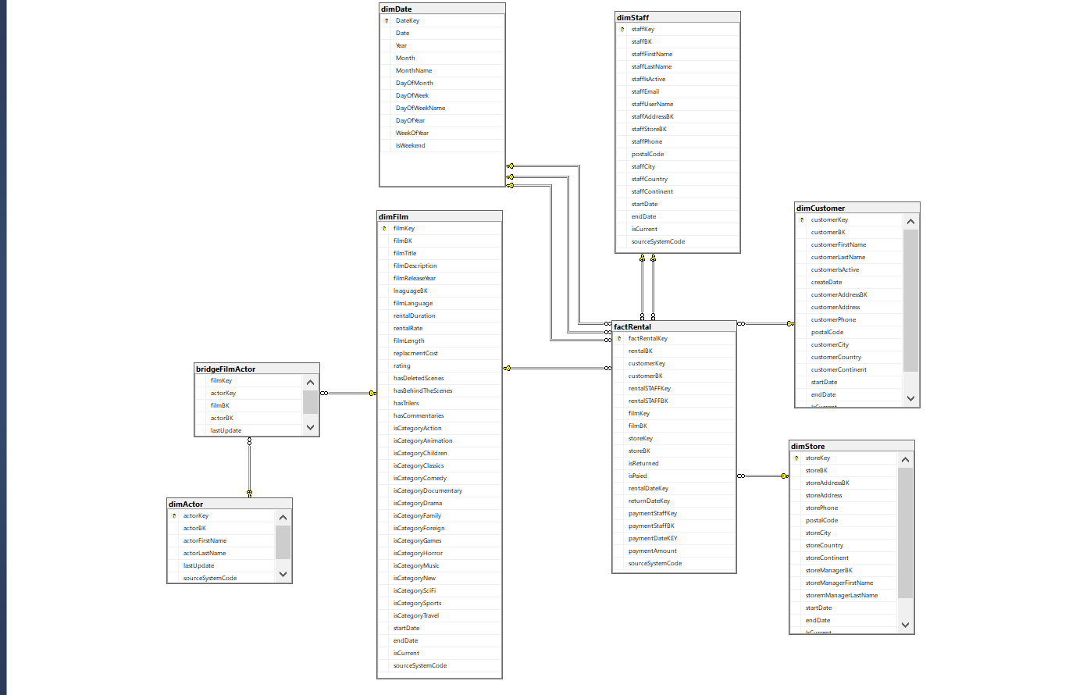
Data warehouse & ETL Layer -Data warehouse Diagram

Slide 15
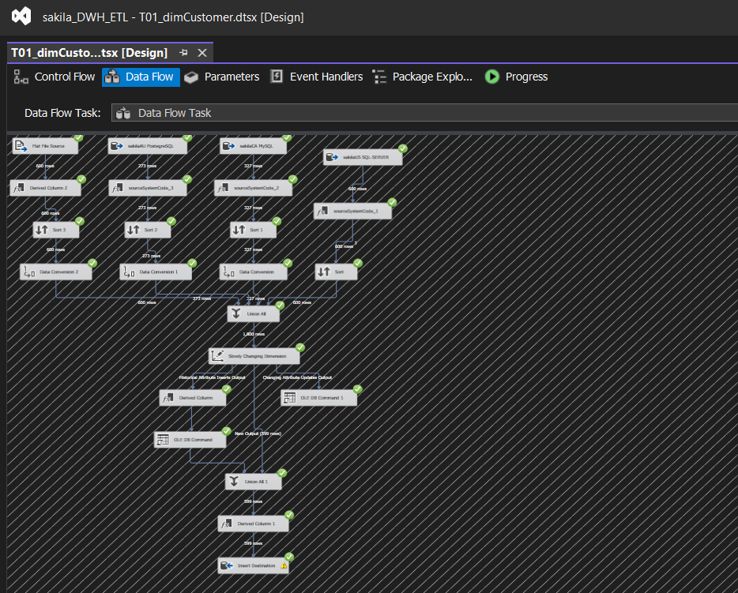
Data warehouse & ETL Layer -ETL : dimCustomer

Slide 16
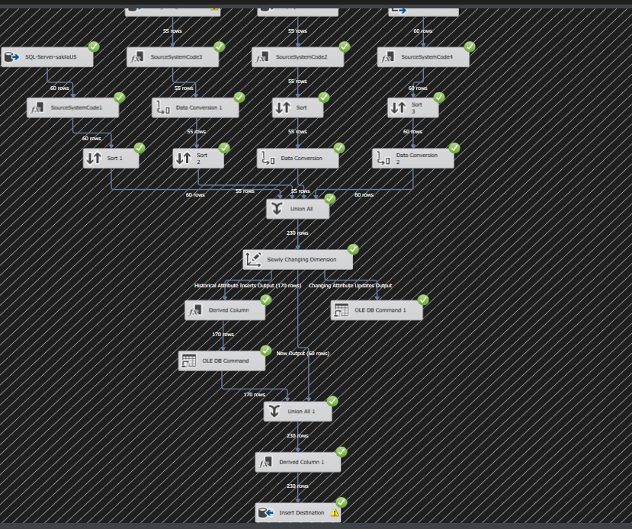
Data warehouse & ETL Layer -ETL : dimStaff

Slide 17
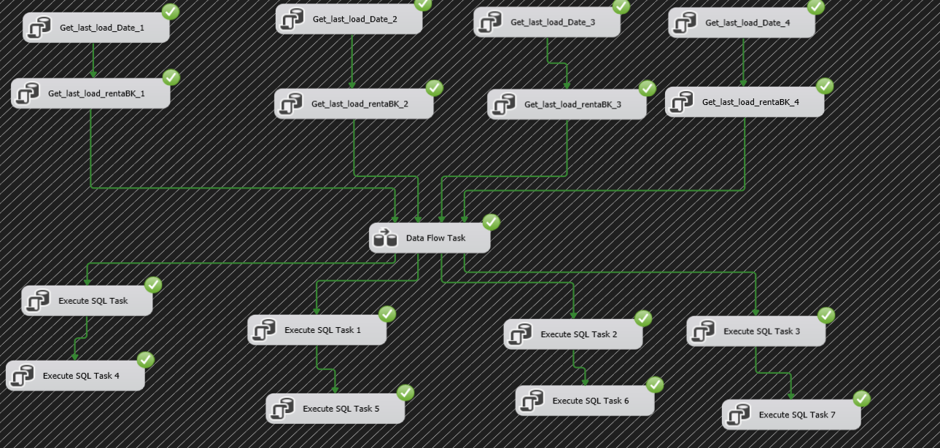
Data warehouse & ETL Layer -ETL : factRentals

Slide 18
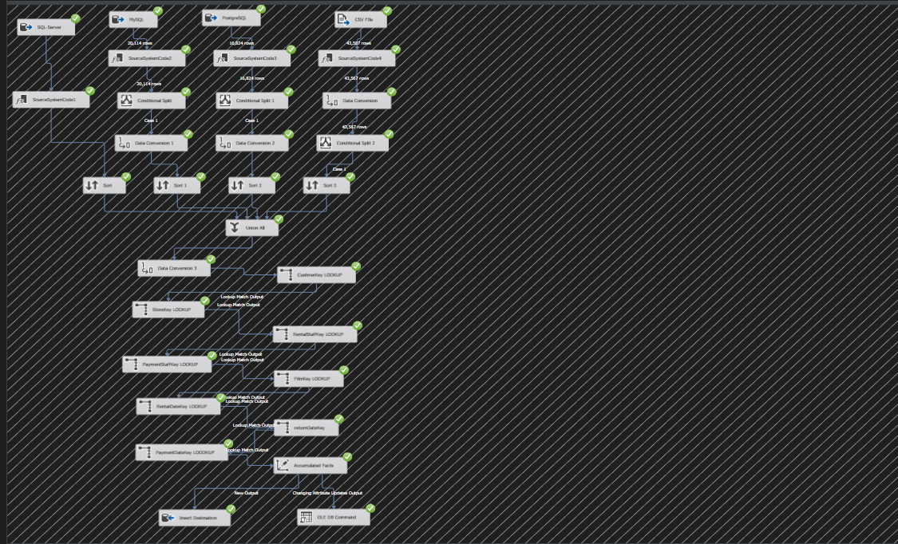
Data warehouse & ETL Layer -ETL : factRentals

Slide 19
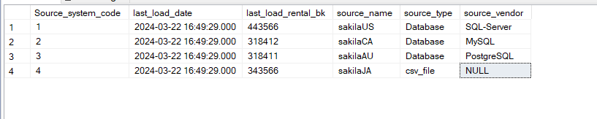
Data warehouse & ETL Layer -ETL : Meta Control table

Slide 20
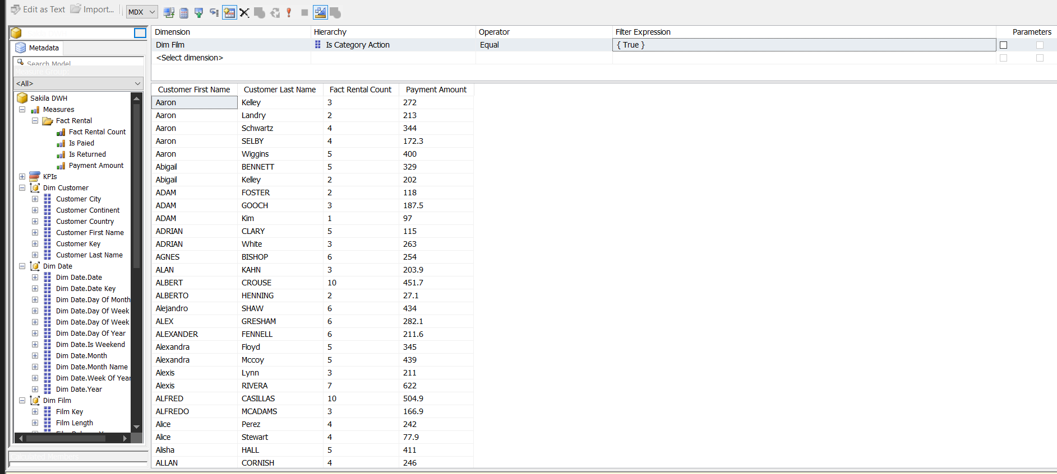
Analysis Layer -Multidimensional Database(cube)

Slide 21
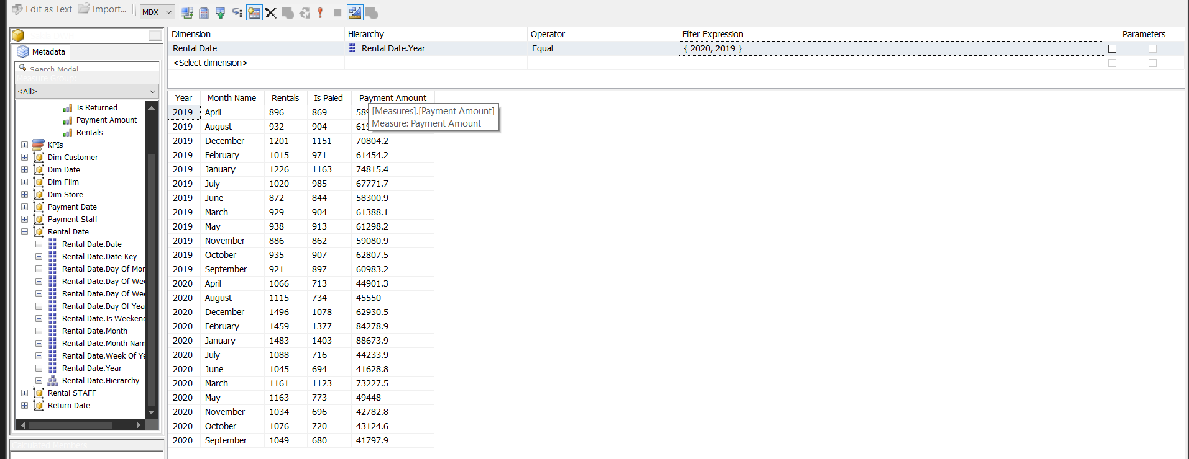
Analysis Layer -Multidimensional Database(cube)

Slide 22
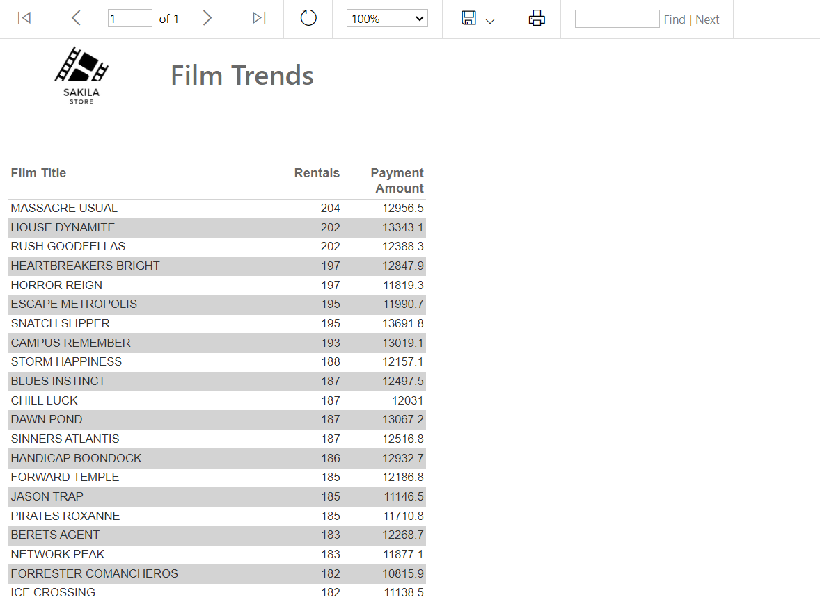
Reporting Layer -SSRS

Slide 23
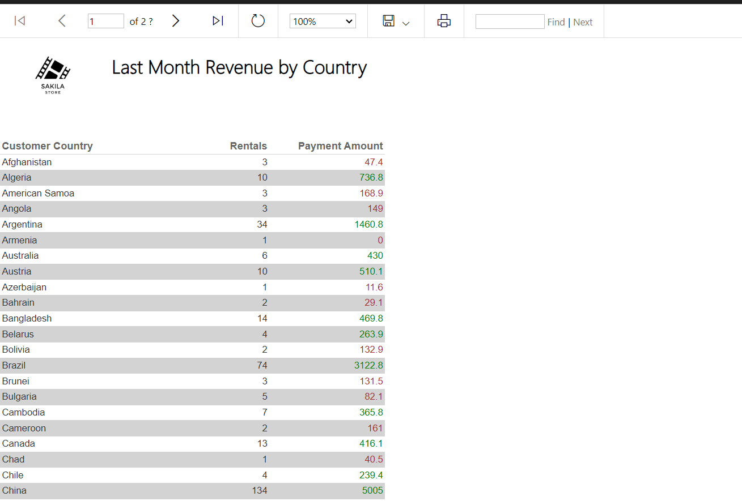
Reporting Layer -SSRS

Slide 24
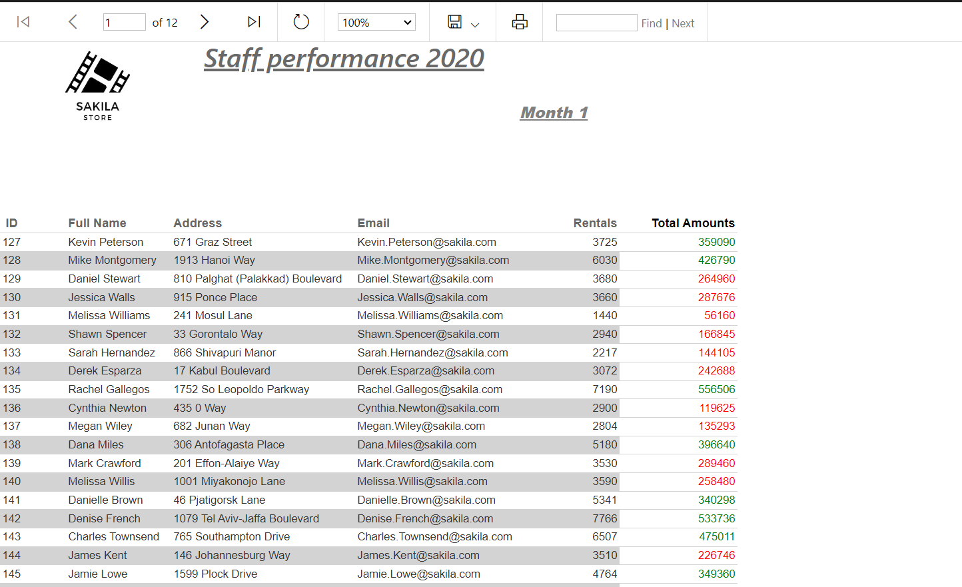
Reporting Layer -SSRS

Slide 25
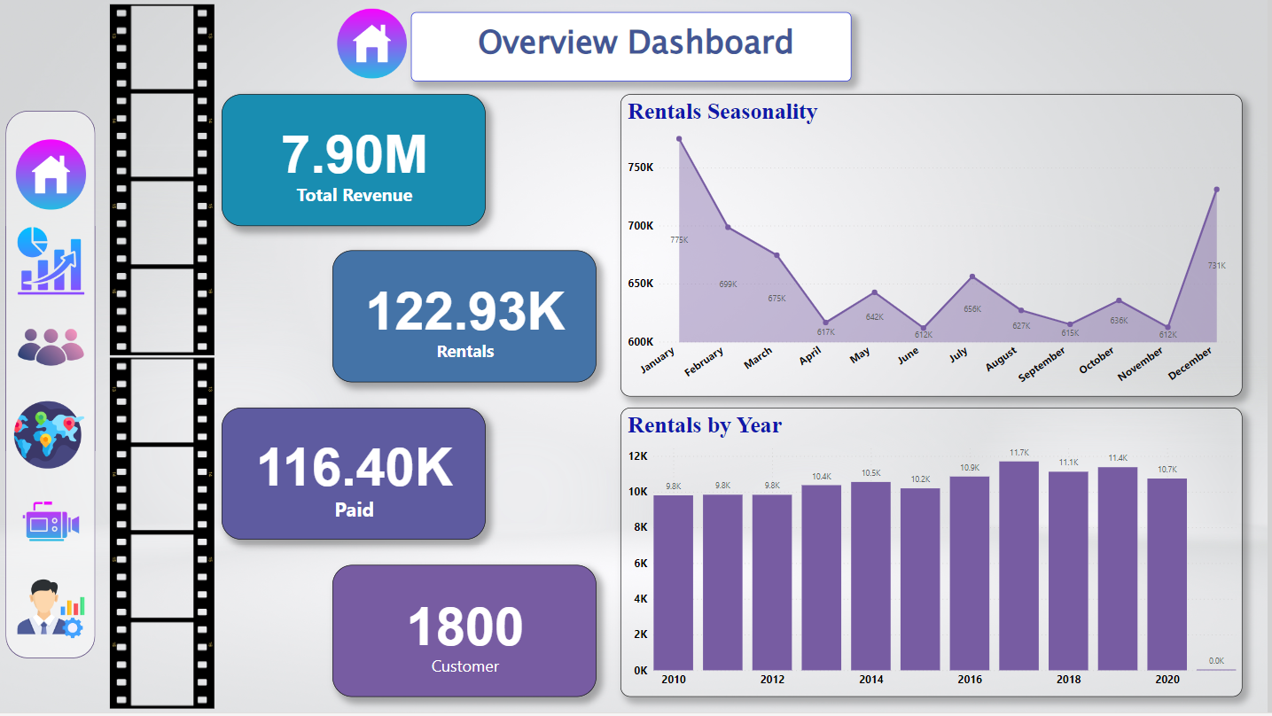
Reporting Layer -Power-BI

Slide 26
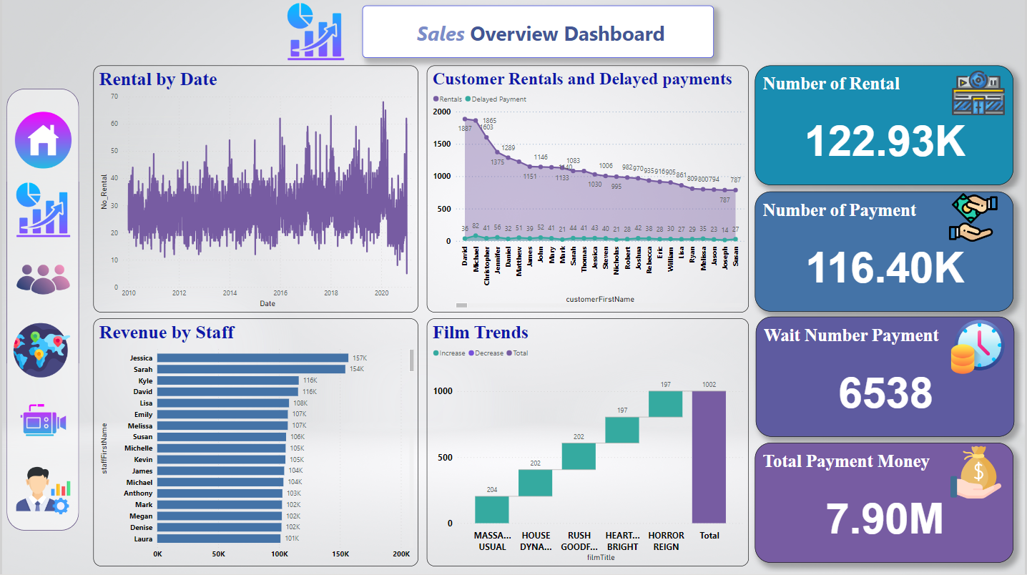
Reporting Layer -Power-BI

Slide 27
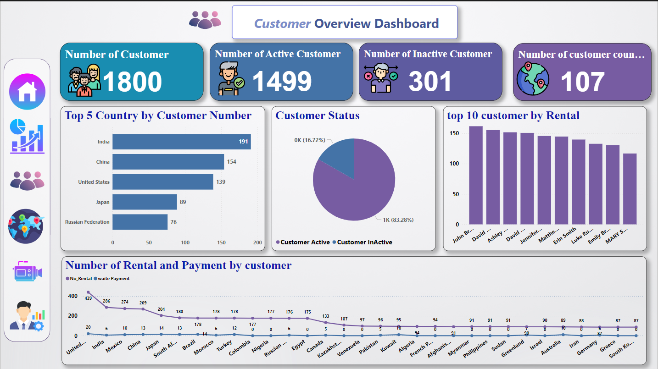
Reporting Layer -Power-BI

Slide 28
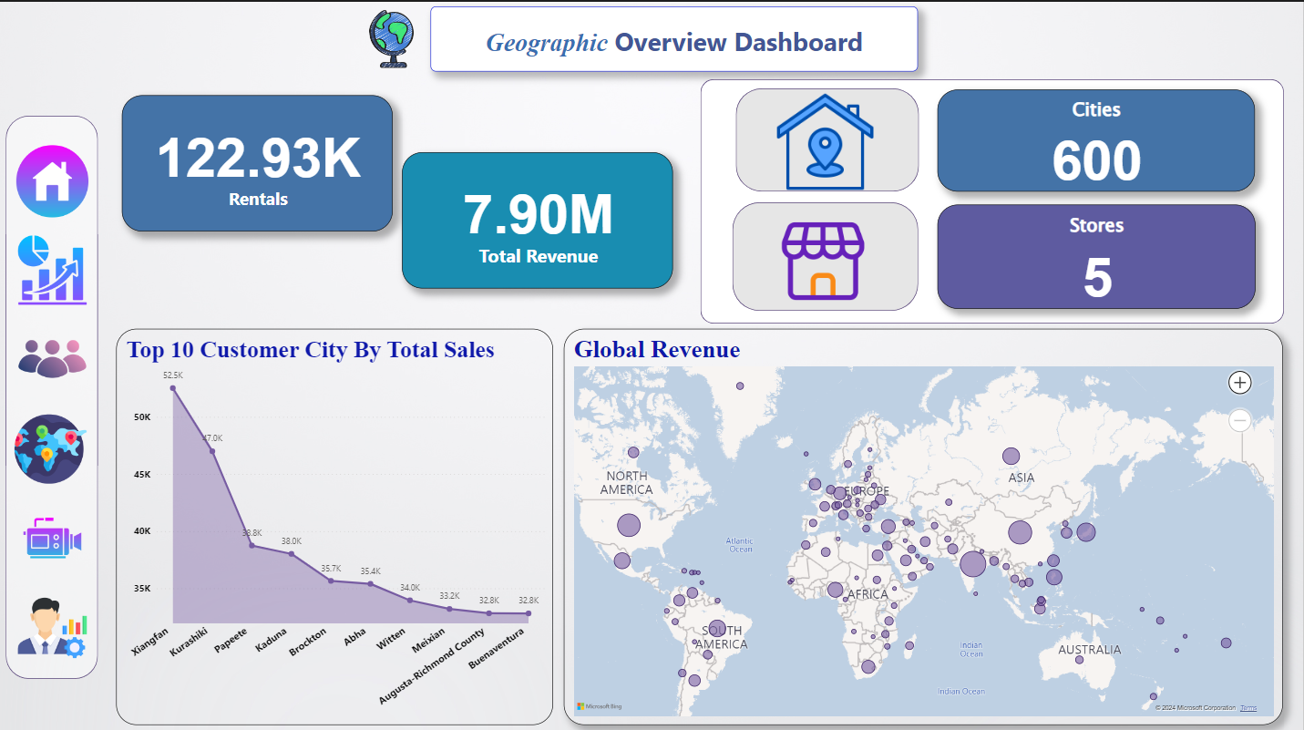
Reporting Layer -Power-BI

Slide 29
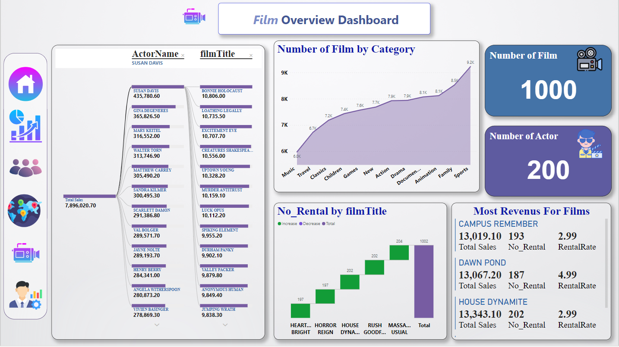
Reporting Layer -Power-BI

Slide 30
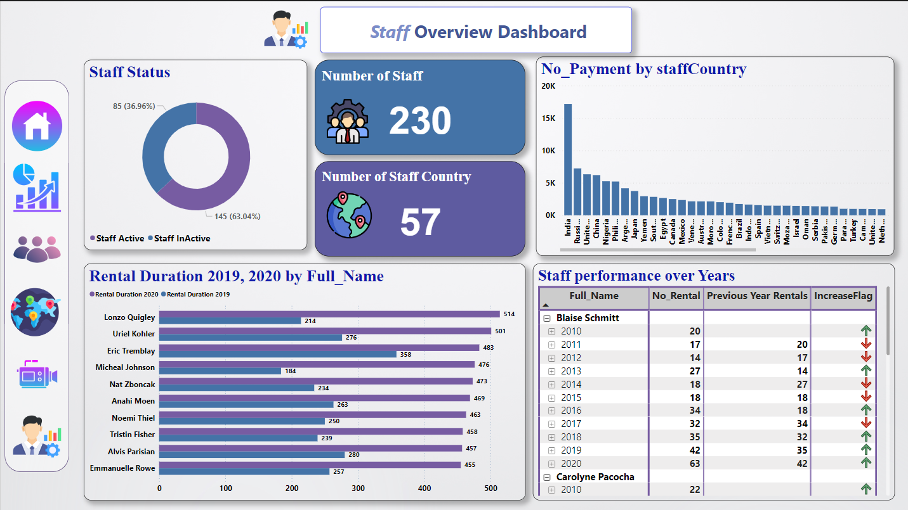
Reporting Layer -Power-BI

Slide 31
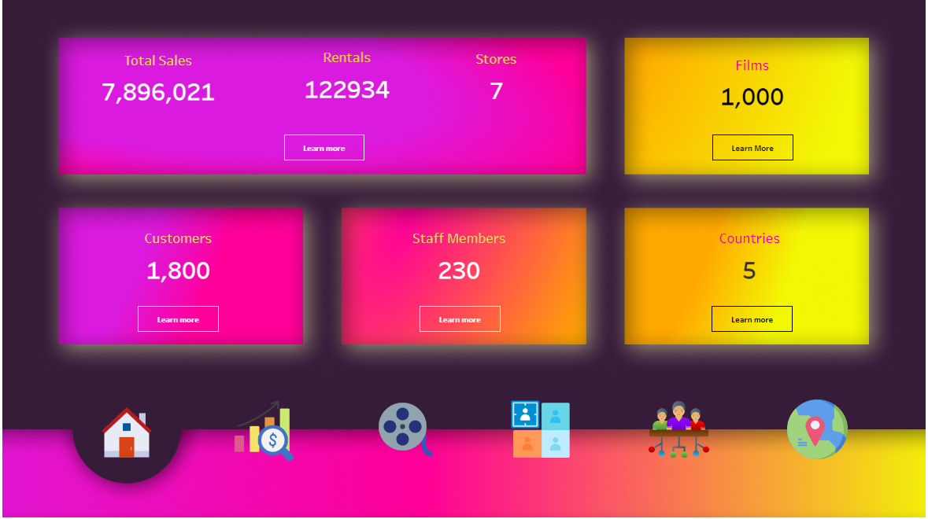
Reporting Layer -Tableau

Slide 32
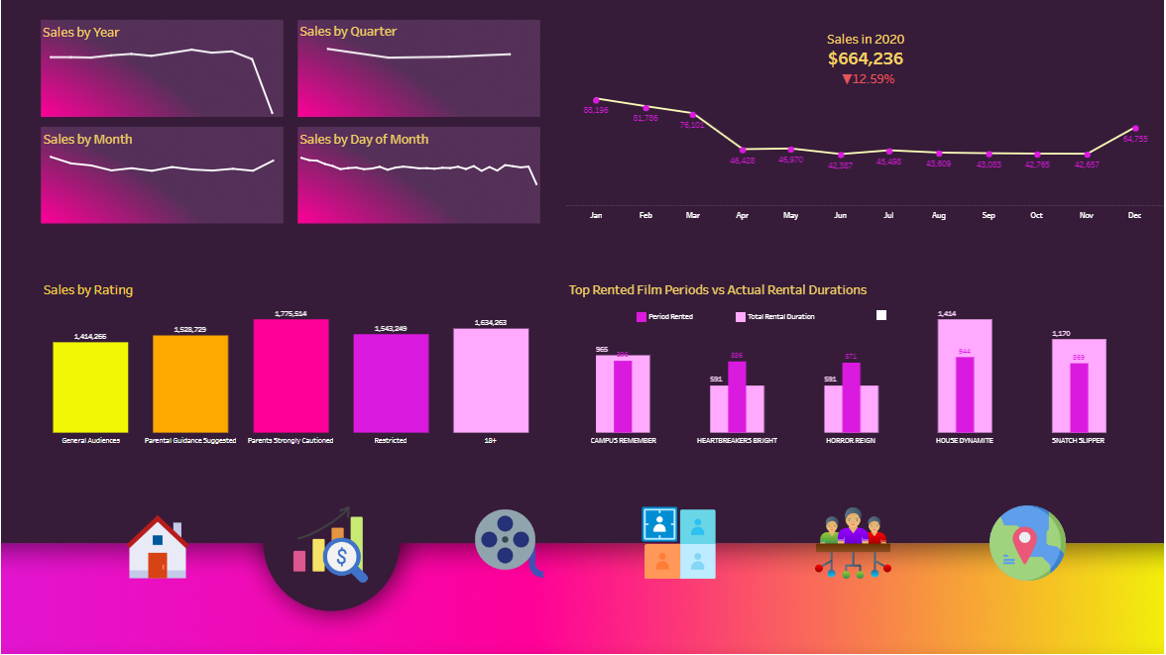
Reporting Layer -Tableau

Slide 33
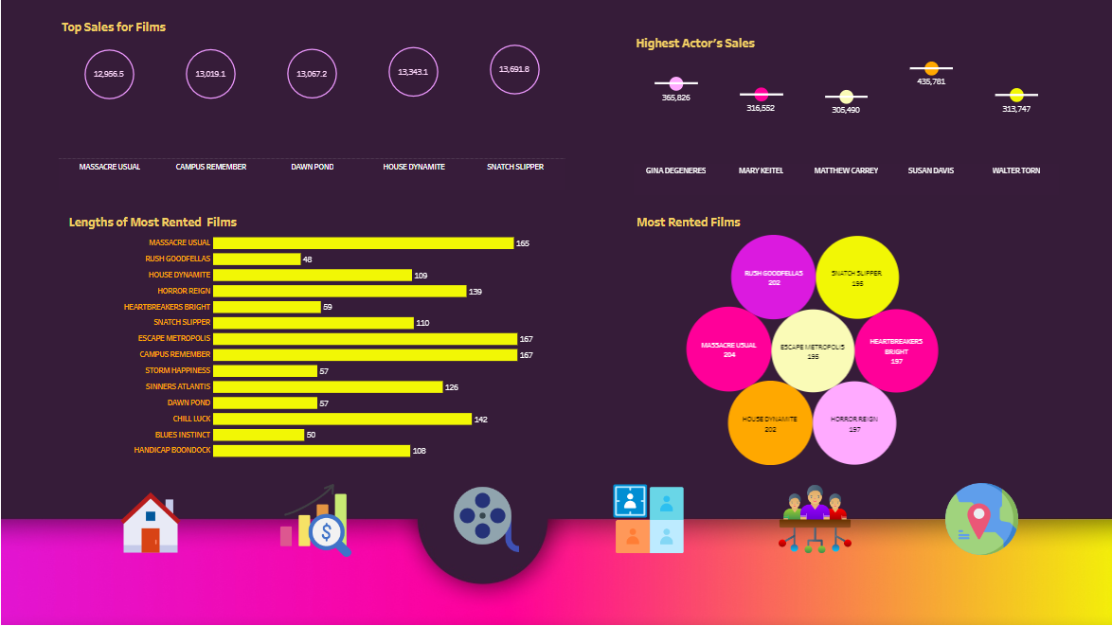
Reporting Layer -Tableau

Slide 34
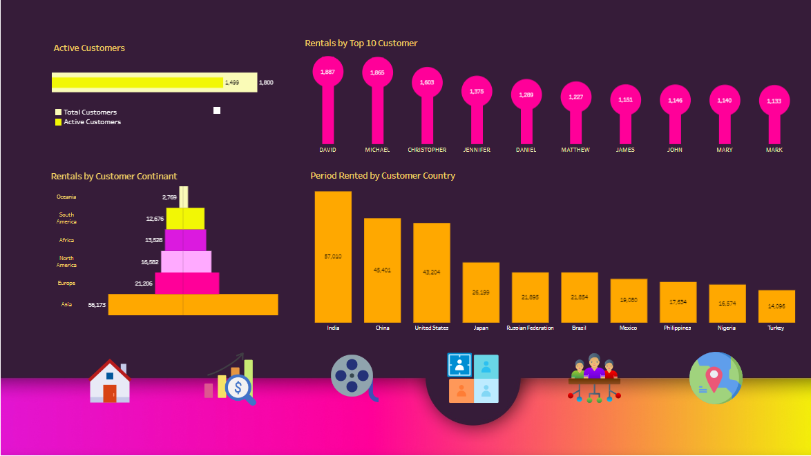
Reporting Layer -Tableau

Slide 35
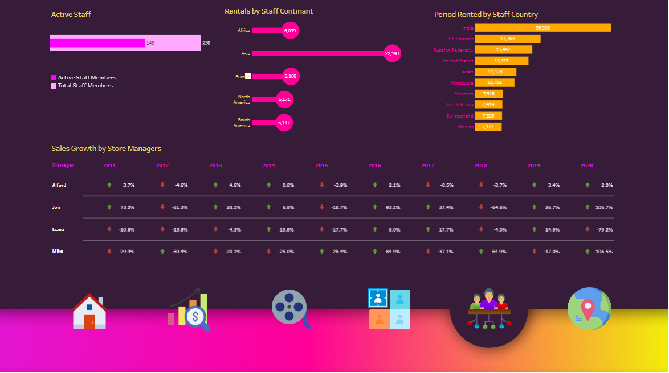
Reporting Layer -Tableau

Slide 36
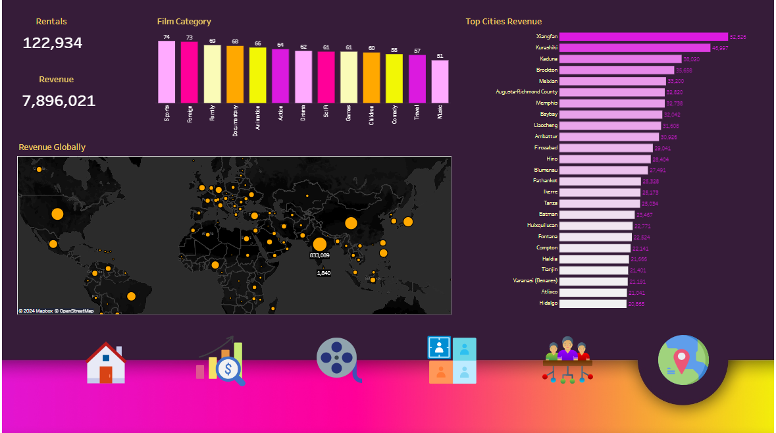
Reporting Layer -Tableau

Slide 37
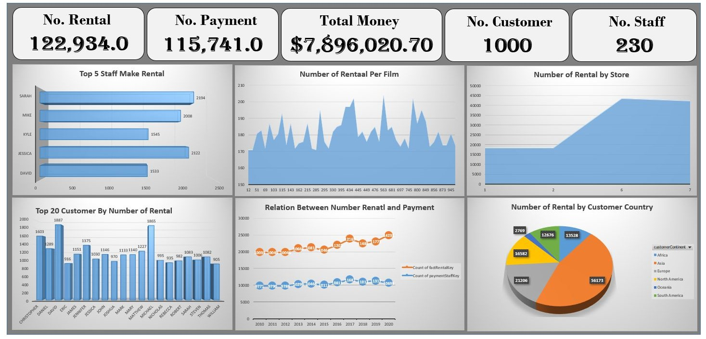
Reporting Layer -Excel

